Slide 1
Object Detection with deep learning
With a focus on two stage detectors

Slide 2
Content
Computer vision: First steps.
A walk through from from Viola-Jones and HOG to FasterRCNN:
Scratch the surface on the different techniques.
Going in details for the RCNN family.
Practice:
Pytorch + DataLoader + FasterRCNN
Image augmentation effect
Freezing layers.
Some of the slides are taken from the computer vision course of Prof Leal-Taixé (TUM.de):
https://dvl.in.tum.de/teaching/cv3dst-ss22/

Slide 3

Computer Vision

Slide 4
Steps to implement and deliver a computer vision product
Ask the right question:
Do I need to detect objects location only?
Do I need to know the total area covered by something?
….
Choose an annotation platform:
CVAT (Open source – Free).
V7 Labs (Paid – but user friendly, especially for segmentation).
SuperAnnotate (Paid – also user friendly for segmentation).
LabelBox (paid – Free version available but images will become open source)
Microsoft Azure annotation tool (good for object detection and keypoints)
Choose a computing platform:
Azure, AWS, …
On-premise (you need GPUs).

Slide 5
Choose a deep learning library:
Keras, Pytorch, …
Prepare data and DataLoader classes.
Train, evaluate, hyperparameter tuning, save model for later use.
Deployement:
Another story that is often hidden from us (researchers) but very important especially in the context of open data/code/models … world.
Serving.
Re-iteration (Mlops)

Slide 6
The computer vision world is not easy to navigate
Lots of tools/frameworks/libraries.
Lots of models available.
Images with big size are not easy to handle:
You need to be patient for upload, download and even visualization.
Images contain more noise than tabular data:
Images taken in different illumination levels, different heights, different cameras, … (Same input, multiple outputs).
Anyone wants to share an experience about this issue?
The goal is not to discuss all the tools here, but rather give you a starting point.

Slide 7
Annotations (ground truth) format

Slide 8
The annotations structure depends on the problem at hand
Classification: image name + class:
Image 1, apple
Image 2, orange
Image 3, passion fruit
…

Slide 9
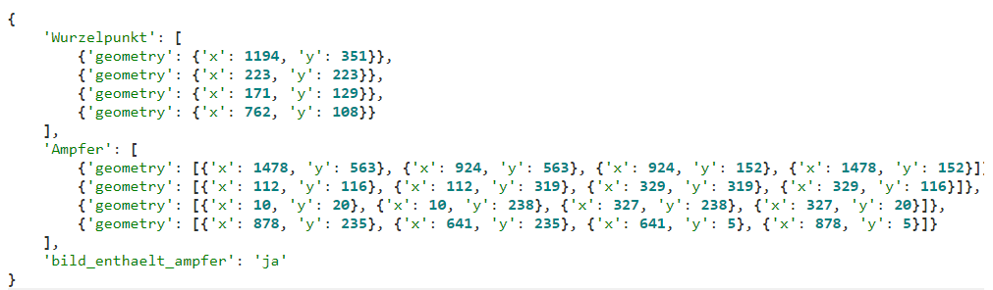
The annotations structure depends on the problem at hand
Object detection: image name + list of (bounding box, class)
Image 1, [bbox1, bbox2, …], [orange, apple, …]

Slide 10
The annotations structure depends on the problem at hand
Segmentation: image name + list of (masks, class)
Usually:
Json
Xml
Text files
Image masks
(Azure) MLTable

Slide 11
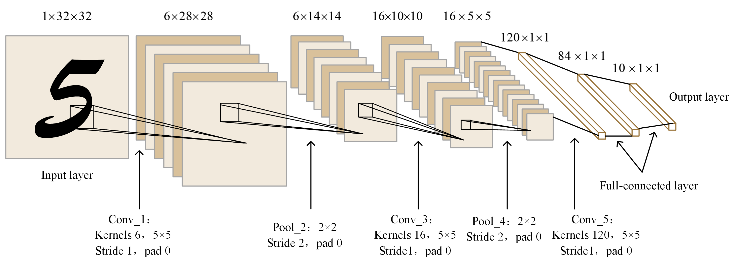
Image classification
The architecture of the LeNet-5 network. The output shape is channel × height × width. Each convolutional layer uses size 5 × 5, padding 0, strides 1. Each pooling layer size 2 × 2 and strides 2.

Slide 12
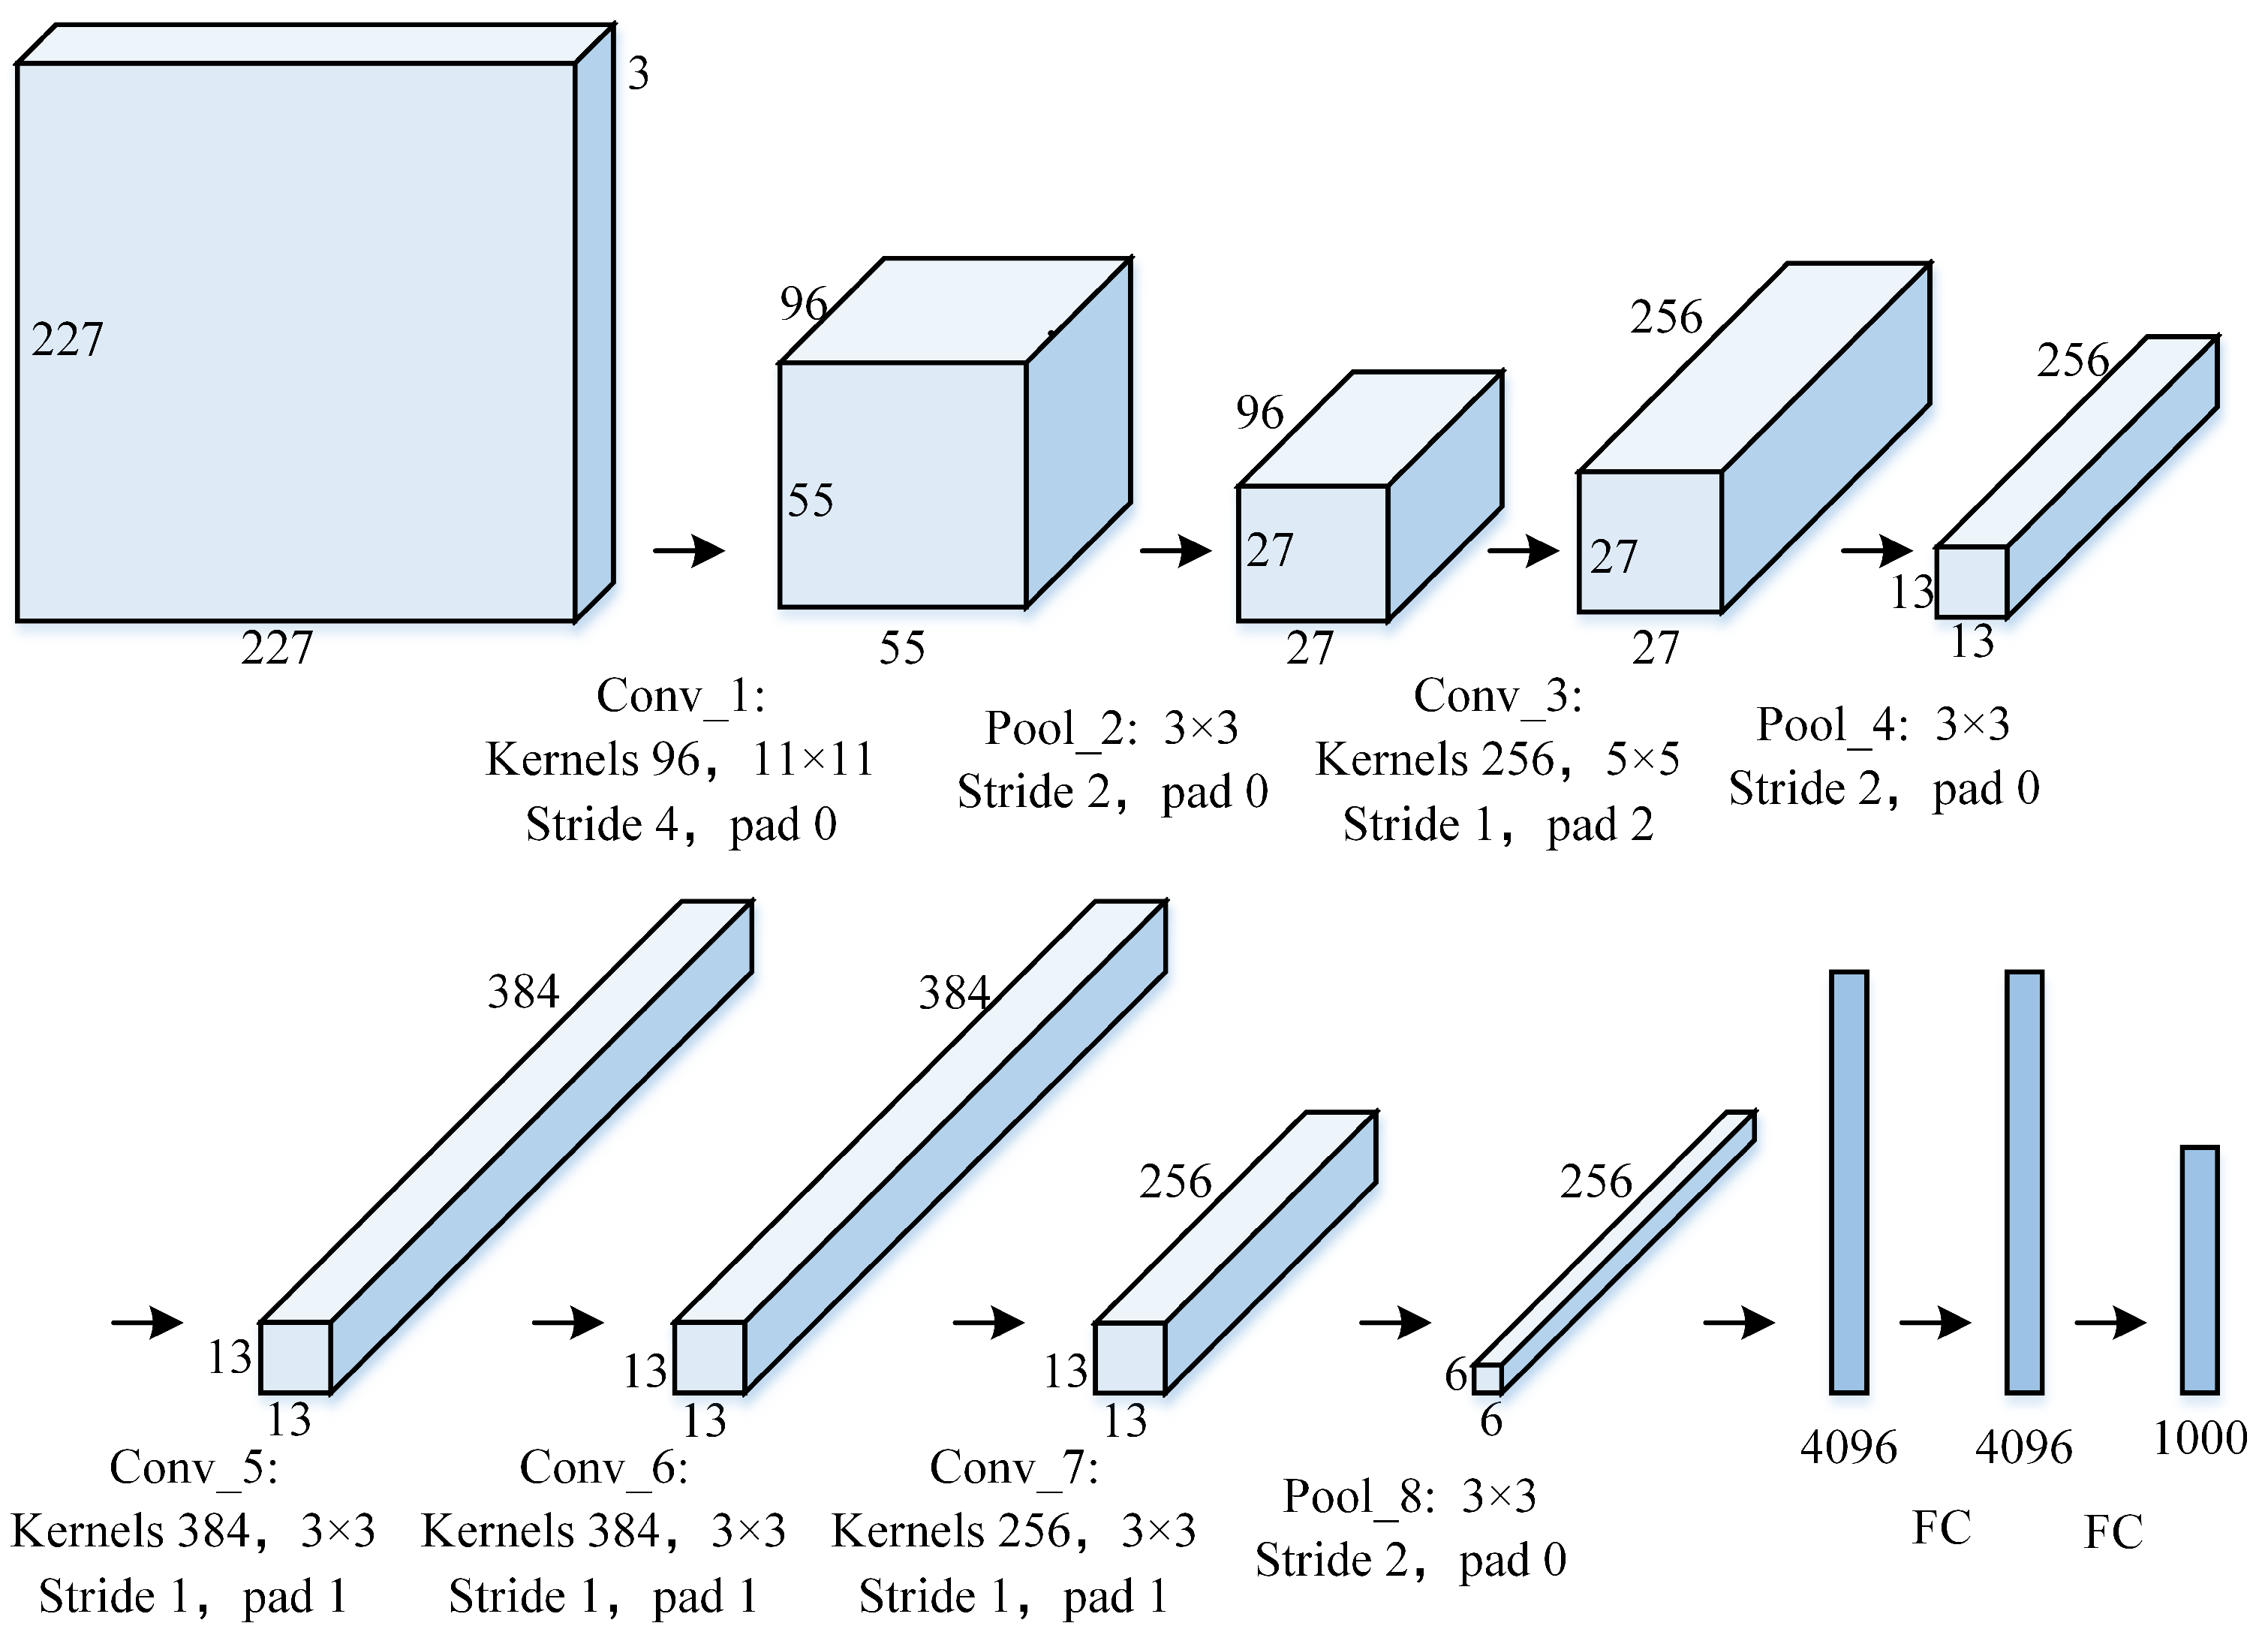
AlexNet
The architecture of the AlexNet network. The convolution size in the first layer is 11 × 11, the second layer is reduced to 5 × 5, and then all 3 × 3 is adopted. Conv_1, Conv_2, and Conv_5 layers are followed by a max-pooling layer with size 3 × 3 and strides 2. Finally, there are two fully connected layers of 4096 and an output layer of 1000 categories.

Slide 13
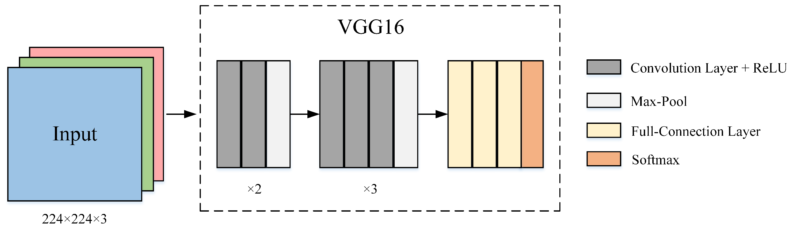
VGG16
The architecture of the VGG-16 network. Conv: size = 3 × 3, stride = 1, padding = 1. Pool: size = 3 × 3, stride = 2.

Slide 14

Reference for the previous 3 images

Slide 15
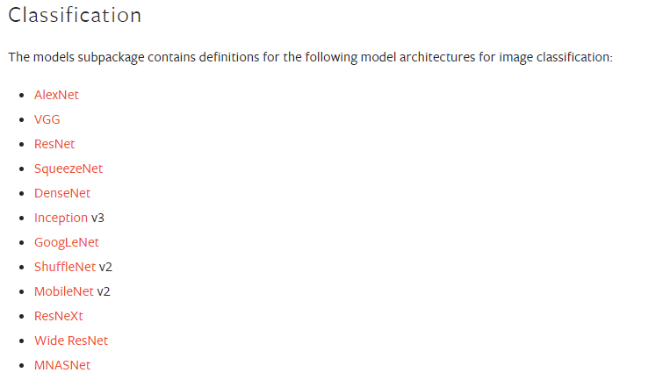
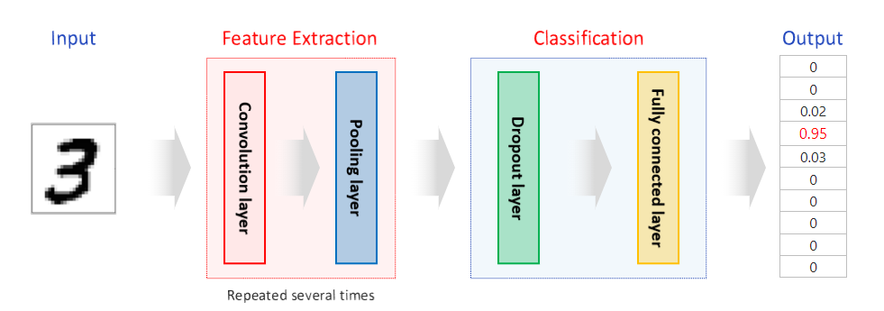
Other well known architectures

Slide 16
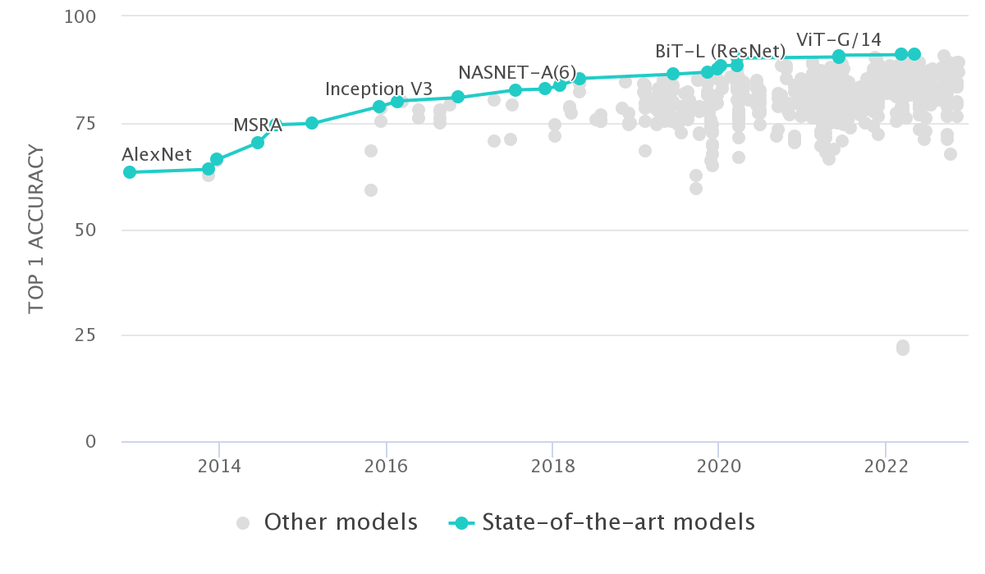
Classification benchmarks
https://paperswithcode.com/sota/image-classification-on-imagenet

Slide 17
The question is …
Now we are able to classify images very well:
How is it possible to localize objects inside images and then classify them?

Slide 18
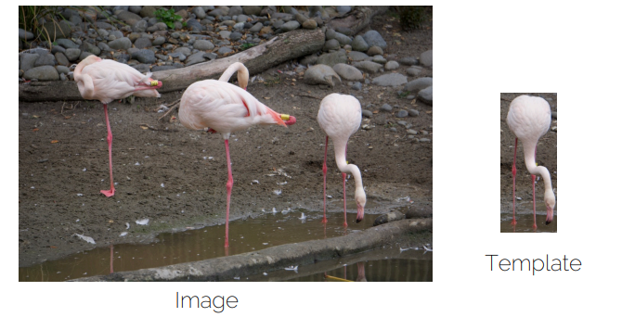
A straightforward proposal:
Template matching + Sliding window

Slide 19
A straightforward proposal:
Template matching + Sliding window

Slide 20
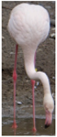
A straightforward proposal:
Template matching + Sliding window
Different regions, low correlation

Slide 21
A straightforward proposal:
Template matching + Sliding window
Similar regions, high correlation

Slide 22
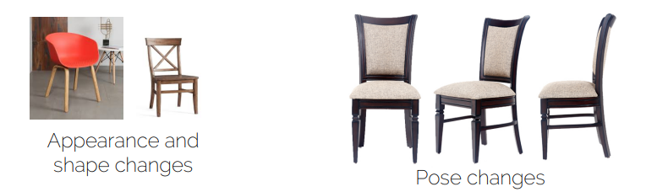
Problems
Occlusion: we need to see the whole object.
Works for a given instance but not a class.
Pose changes, scales and aspect ratio.

Slide 23
Other techniques
Feature detector using classical image processing techniques + Classifier:
Viola-Jones detector (Classifier = AdaBoost). Originally introduced for face detection but could be applied to any other class.
Histogram of Gradient (Classifier = SVM). Originally introduced for pedestrian detection.
Problems: features should be hand crafted per object + a set of features of each pose and instance of the class.
Toward general object detection?

Slide 24
Few terms
Objectness and Region Proposal Methods.
Non-Maxima Suppression and Intersection over Union

Slide 25
Objectness
How likely a region (of an image) contains an object?
Objectness measure ➔ Set of Proposals.
Object proposal methods:
Selective search: van de Sande et al. Segmentation as selective search for object recognition. ICCV 2011.
Edge boxes: Zitnick and Dollar. Edge boxes: locating object proposals from edges. ECCV 2014

Slide 26
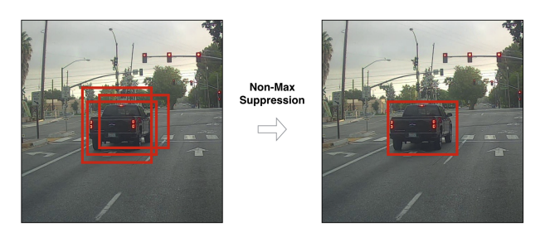
Non-Maxima Suppression
We do not need all proposals:
We need a method to quantify the best boxes (IOU)

Slide 27
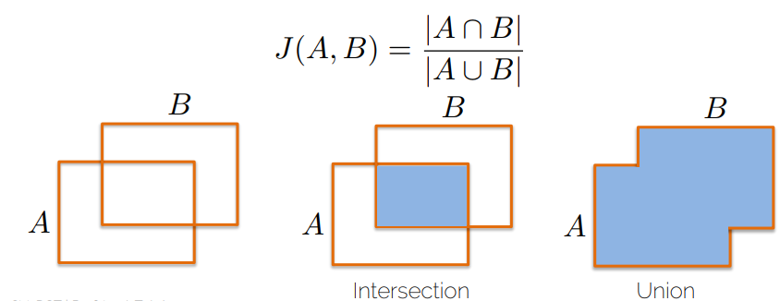
We measure region overlap with the Intersection over Union (IoU) or Jaccard Index:

Slide 28
Available OD algorithms
Some review papers:
https://arxiv.org/pdf/1807.05511.pdf
https://www.sciencedirect.com/science/article/pii/S2666307421000267
Grouping:
Two stage algorithms:
R-CNN family (RCNN, Fast RCNN, Faster RCNN)
SPP-Net, R-FCN, FPN
One stage algorithms:
YOLO, SDD, RetinaNet
ExtremeNet, CornerNet

Slide 29
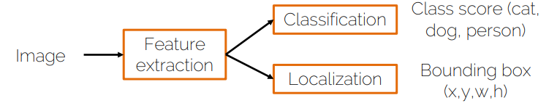
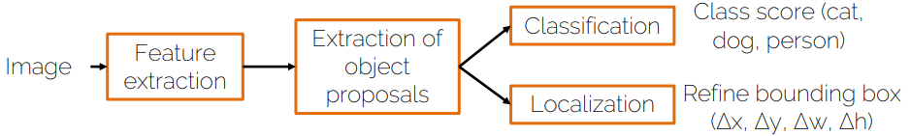
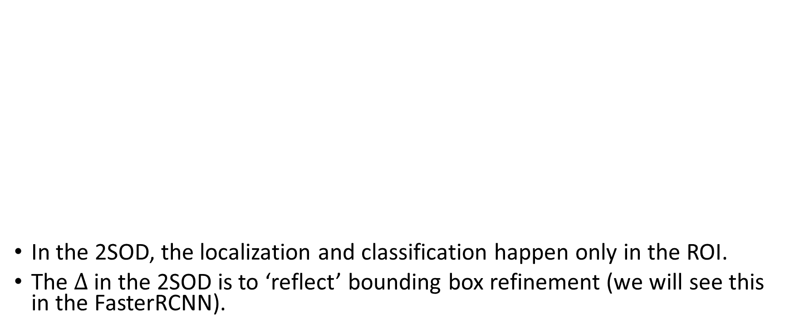
In the 2SOD, the localization and classification happen only in the ROI.
The $∆$ in the 2SOD is to ‘reflect’ bounding box refinement (we will see this in the FasterRCNN).

Slide 30
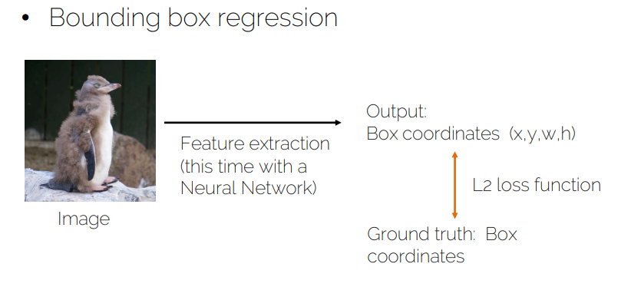
Localization

Slide 31
Localization

Slide 32
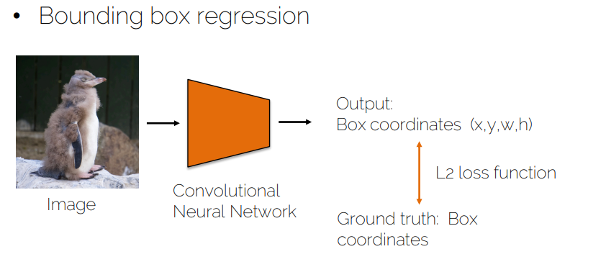

Slide 33
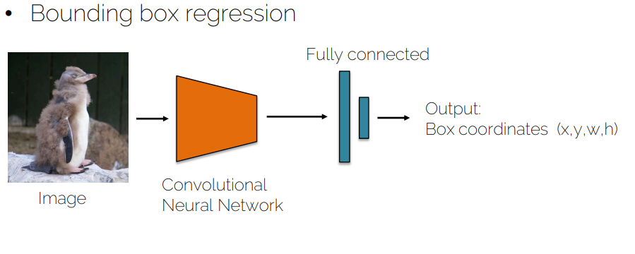

Slide 34
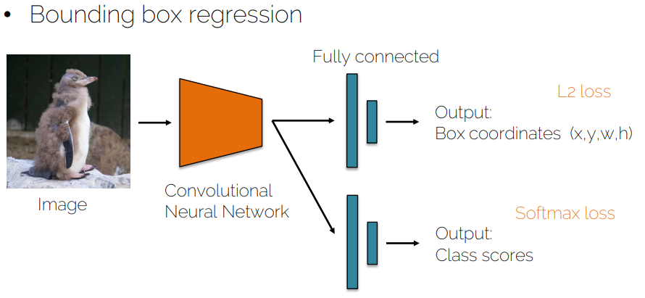
Challenge: What is the loss function that should be used for each output?

Slide 36
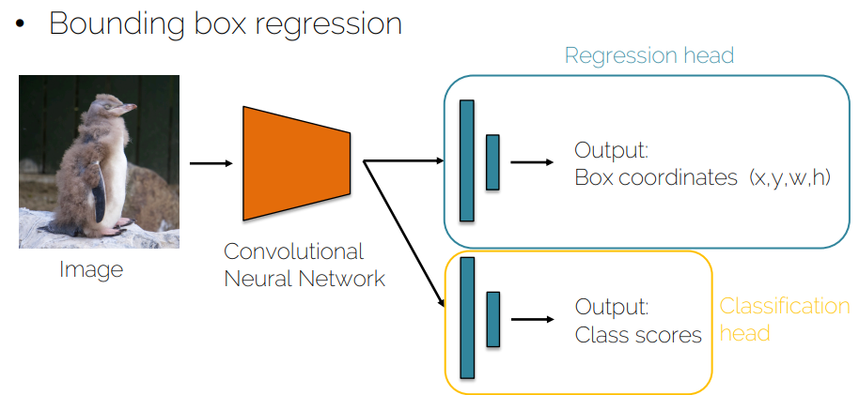

Slide 37
When this type of networks emerged, we used to train the classification head first (while regression head parameters are frozen) and then freeze classification head parameters to train the regression head (inference time: we use both by book).
Now, we know how to merge the two losses and we train both heads at the same time.

Slide 38
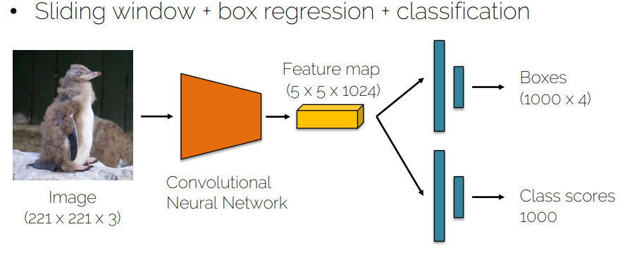
OverFeat:
OverFeat: Integrated Recognition, Localization and Detection using Convolutional Networks. Semanet et al 2013.

Slide 39
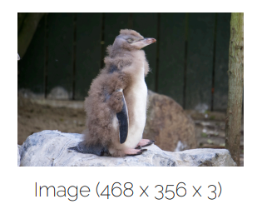

Slide 40
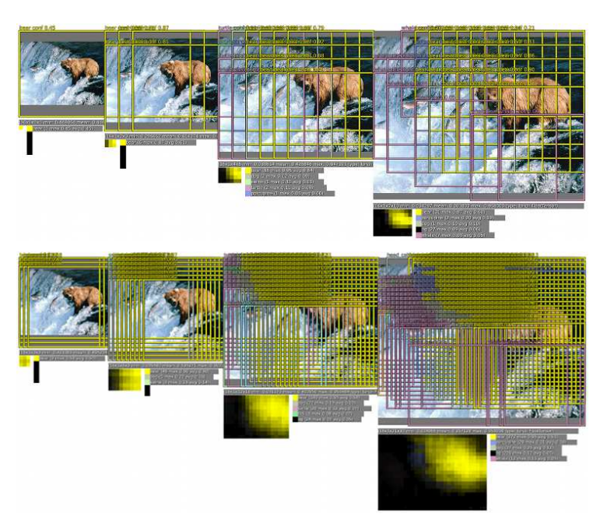
Repeat the sliding window at multiple scales

Slide 41
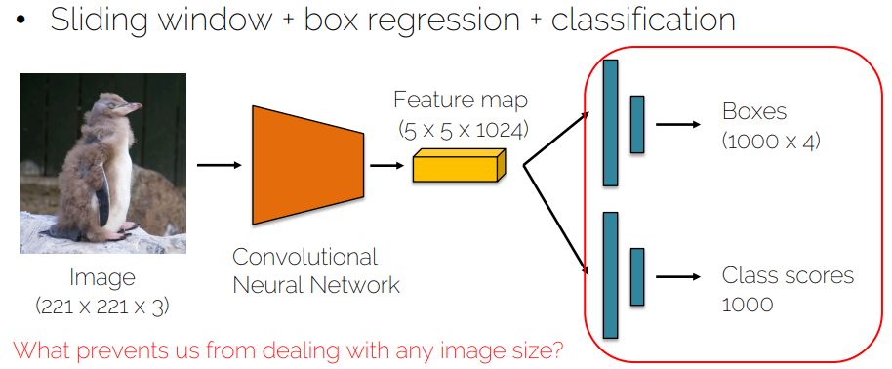
What would be the problem(s) here?

Slide 42
We can’t detect overlapping objects:
Why? The network output is fixed to 4 values for regression.
To detect all non overlapping objects, we need to slide over all the regions ➔ Computationally expensive.
Why not to try to find out a method that allows us to try a subset of regions rather than trying all possible regions?
This is what the R-CNN comes in: Region proposal CNN.

Slide 43
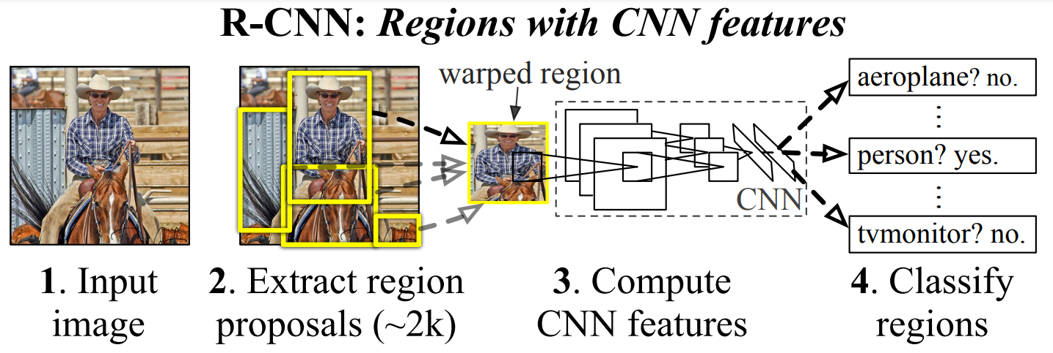
Rich feature hierarchies for accurate object detection and semantic segmentation Tech report (v5) Ross Girshick et al 2014.

Slide 44
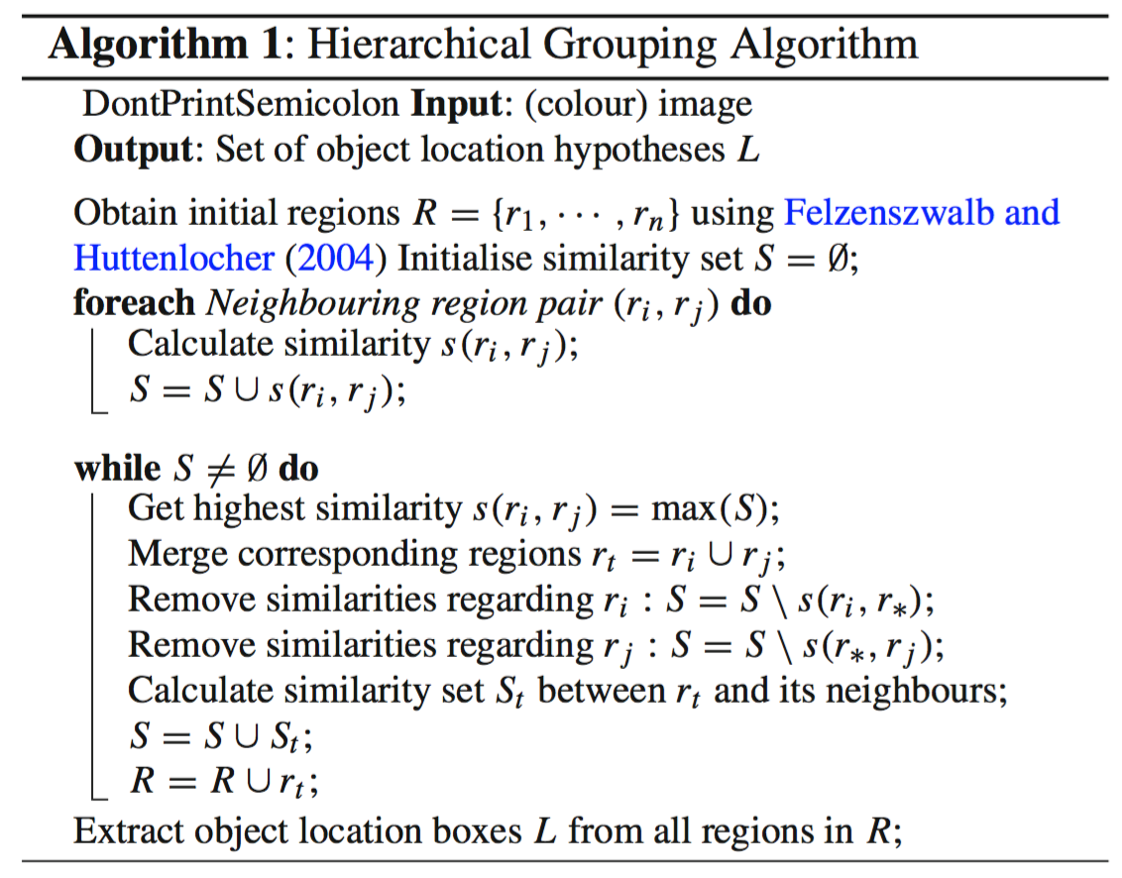
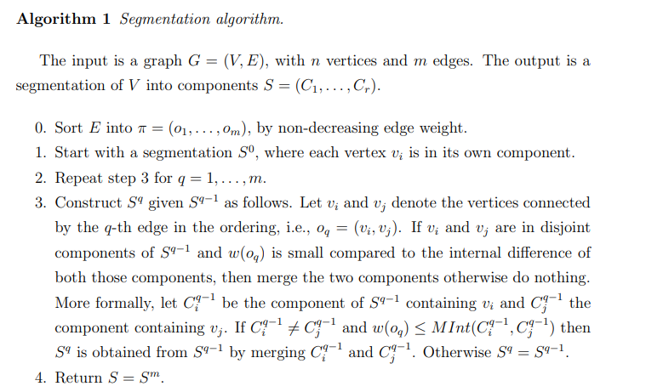
Selective search
Efficient Graph-Based Image Segmentation. Pedro F. Felzenszwalb and Daniel P. Huttenlocher, 2004.
http://people.cs.uchicago.edu/~pff/papers/seg-ijcv.pdf

Slide 45
At the initialization stage, apply Felzenszwalb and Huttenlocher’s graph-based image segmentation algorithm to create regions to start with.
Use a greedy algorithm to iteratively group regions together:
First the similarities between all neighbouring regions are calculated.
The two most similar regions are grouped together, and new similarities are calculated between the resulting region and its neighbours.
The process of grouping the most similar regions (Step 2) is repeated until the whole image becomes a single region
Ref1: https://www.koen.me/research/selectivesearch/
Ref2: https://lilianweng.github.io/

Slide 46
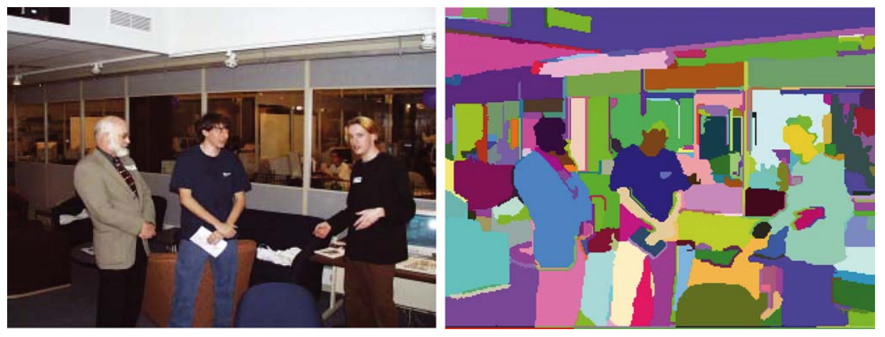
How does it look like?

Slide 47
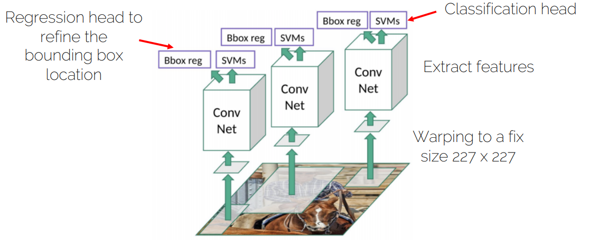
Region proposals are scaled into a fixed size and fed into the CNN (convolutational neural netwrok

Slide 48
Training scheme:
Pre-train the CNN on ImageNet
Finetune the CNN on the number of classes the detector is aiming to classify (softmax loss)
Train a linear Support Vector Machine classifier to classify image regions.
Train the bounding box regressor (L2 loss)

Slide 49
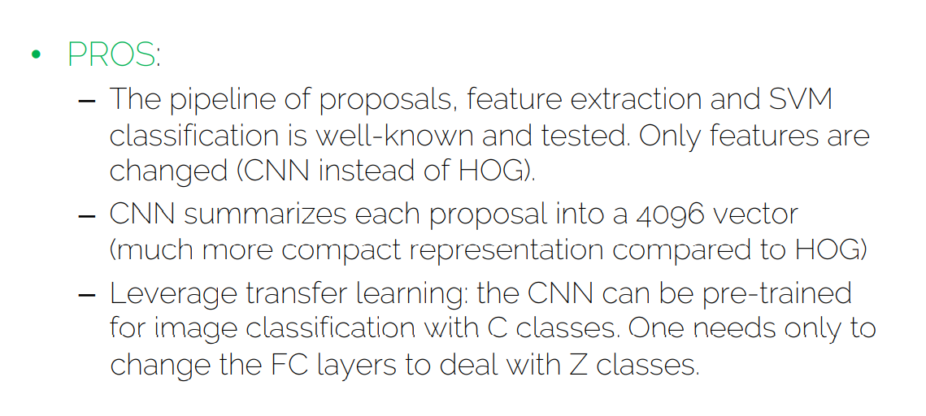

Slide 50
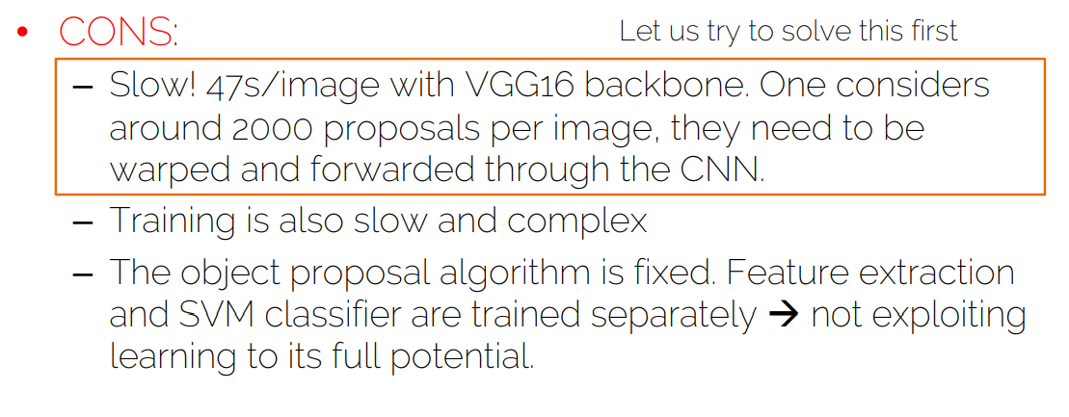
Which means that the region proposal algorithm will no improve by training the CNN.
Challenge: how can we solve the first problem?

Slide 51
The SPP-net solved the problem of time for RCNN. But we still have 2 other problems.
Spatial Pyramid Pooling in Deep Convolutional Networks for Visual Recognition, Kaiming He 2014
Extracting features using one net (rather than 2000 net) and avoiding overlapping (non-useful) feature extractions) ➔ Then, based on the object proposals, extract computed features (some intelligent trick ☺ ).
The convent is frozen.

Slide 52
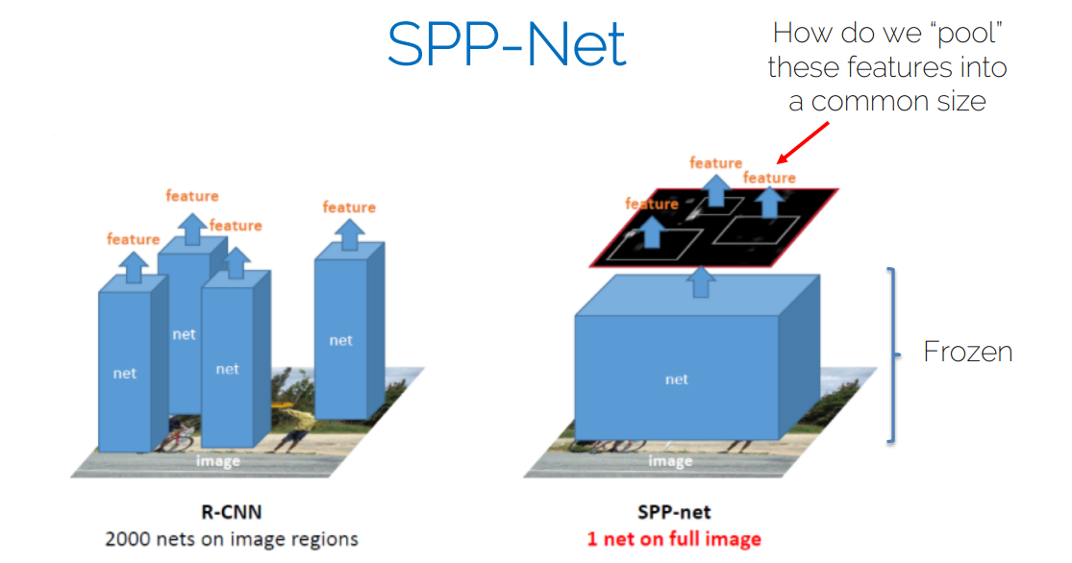

Slide 53
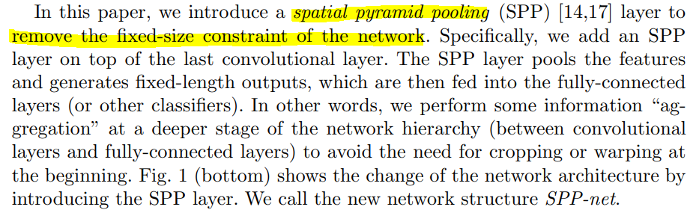
(Max)Pooling features into a fixed size.

Slide 54
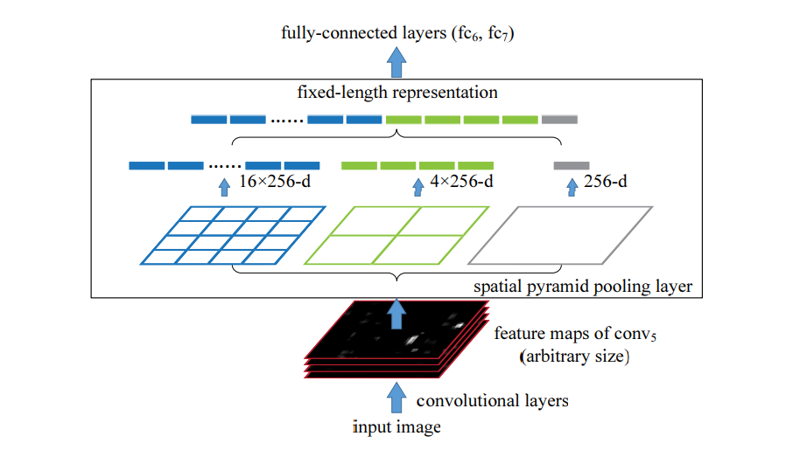
Input of the SPP layer: d feature maps (one feature map per ROI).
Feature maps have different sizes and aspect ratios. Regardless, each FM is pooled into 1 value, 4 values and 16 values that are concatenated into a (16 + 4 + 1) vector of fixed size.

Slide 55
It solved the R-CNN problem of being slow at test time
It still has some problems inherited from R-CNN:
Training is still slow (a bit faster than R-CNN)
Training scheme is still complex
Still no end-to-end training

Slide 56
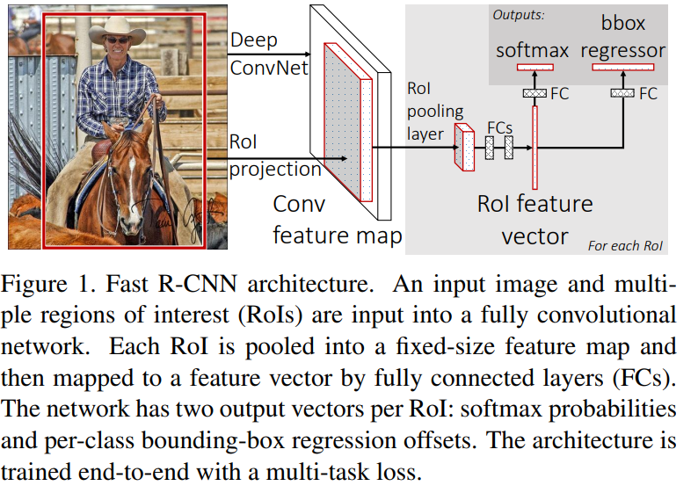

Slide 57
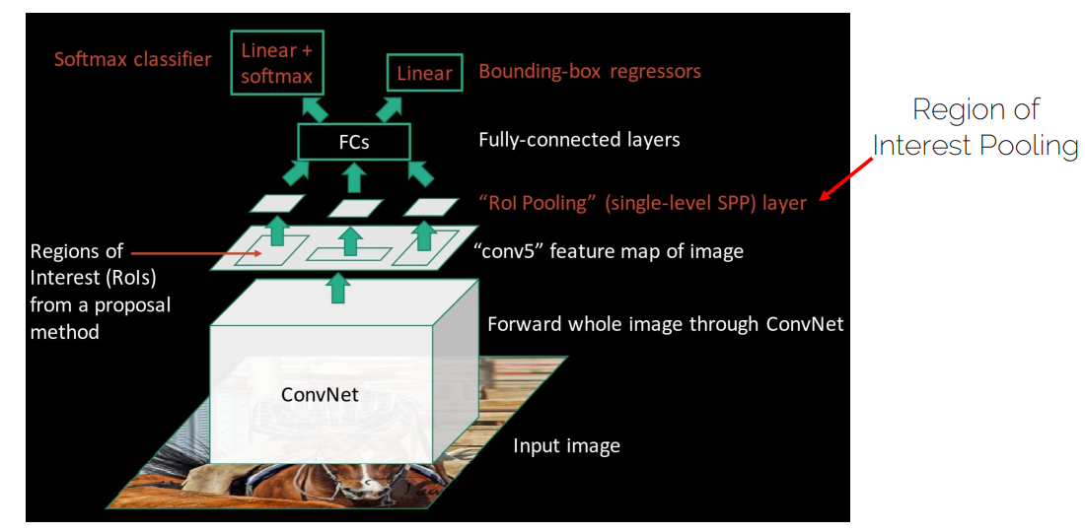
Fast RCNN Vs SPP: The way the ROI pooling is done (SPP with only one pyramid level).
Fast RCNN Vs RCNN: FRCNN Borrowed the concept of one forward on the whole image from SPP (Rather than doing a forward for each ROI).

Slide 58
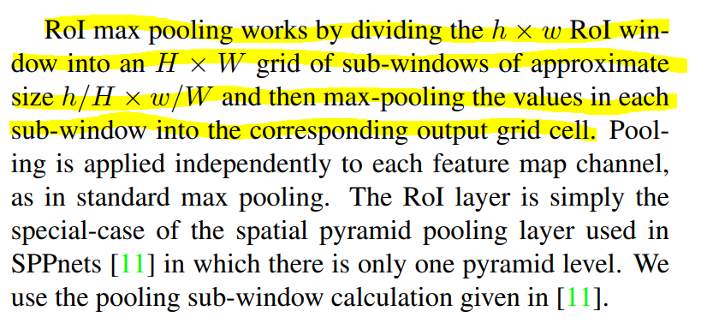
The ROI pooling works to convert any ROI of size hxw to a fixed size HxW that will be fed to the FC layer.
One pyramid?

Slide 59
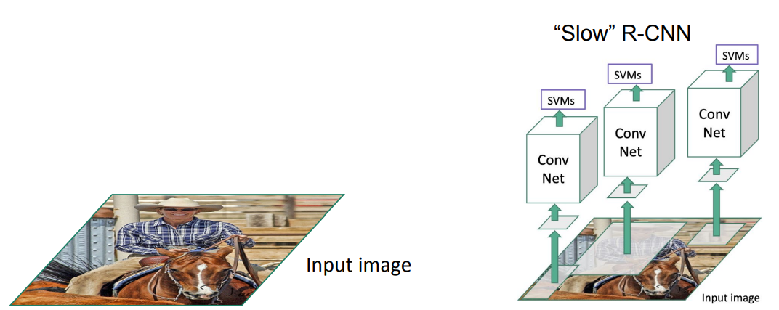
Fast-RCNN

Slide 60
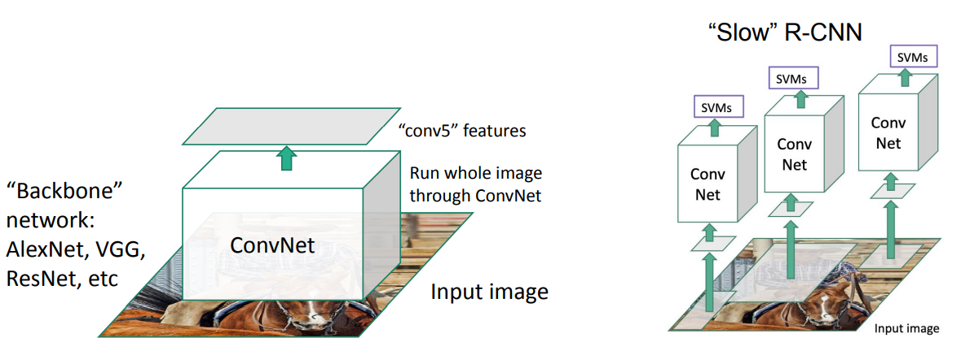
Fast-RCNN

Slide 61
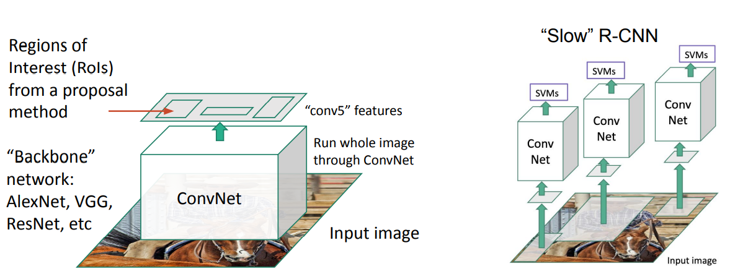
Fast-RCNN

Slide 62
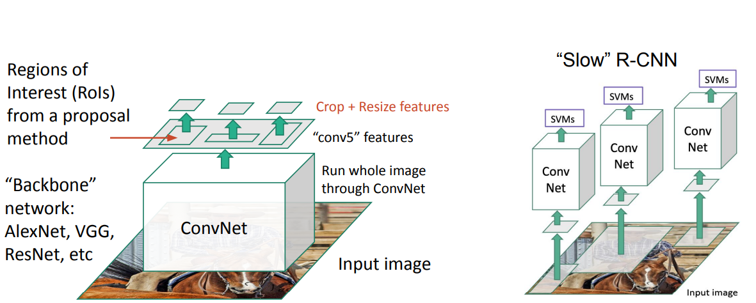
Fast-RCNN

Slide 63
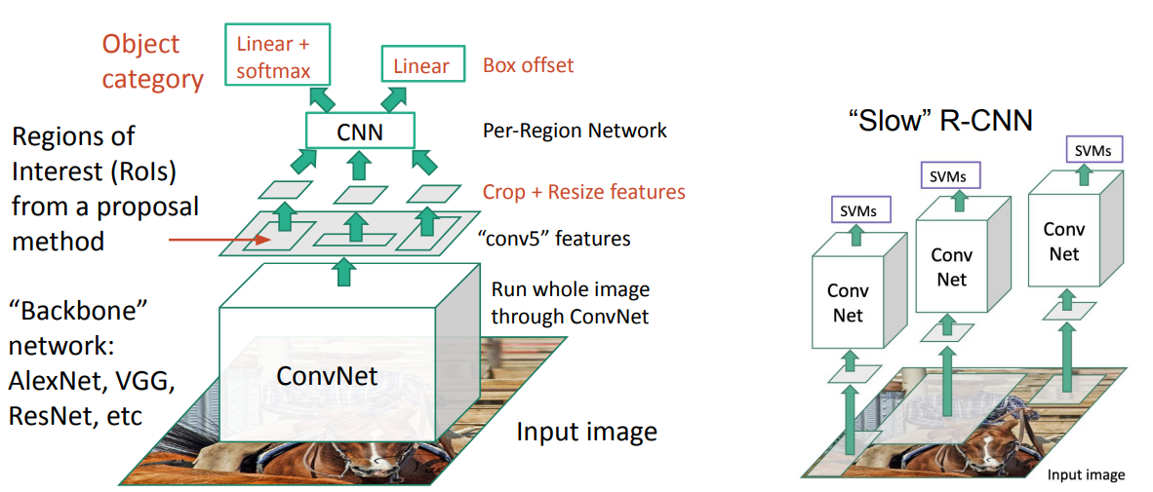
Fast-RCNN

Slide 64
Why does one one convnet pass over the whole image makes the FasterRCNN faster than RCNN where we make a seperate pass over each ROI?
RCNN:
Convnet over 2000 Region proposals ➔ a lot of proposals overlaps ➔ A lot of convolutions will be computed many times (In the picture, we see the ROI separated but in reality, there is an overlap with 2000 proposals per image).
Algorithmically speaking, convolution on the whole image is computationally less expensive than computing the convolution on the crops of the image (even if they are contingent and non overlapping – extra times at the boudaries).
In Fast RCNN:
Region proposals from the ‘feature map’ go through a simple CNN compared to ‘ 2000 region proposals’ from the image which go through a backbone.

Slide 65
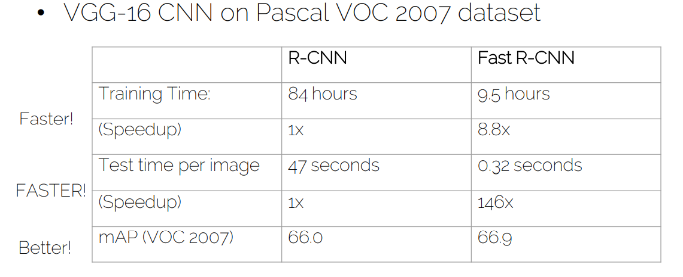

Slide 66
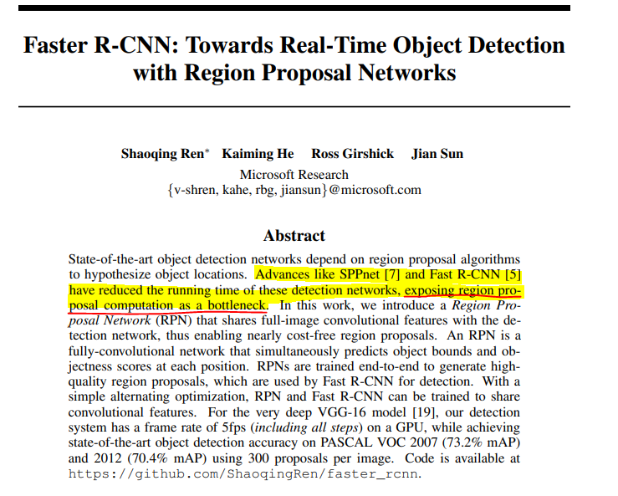
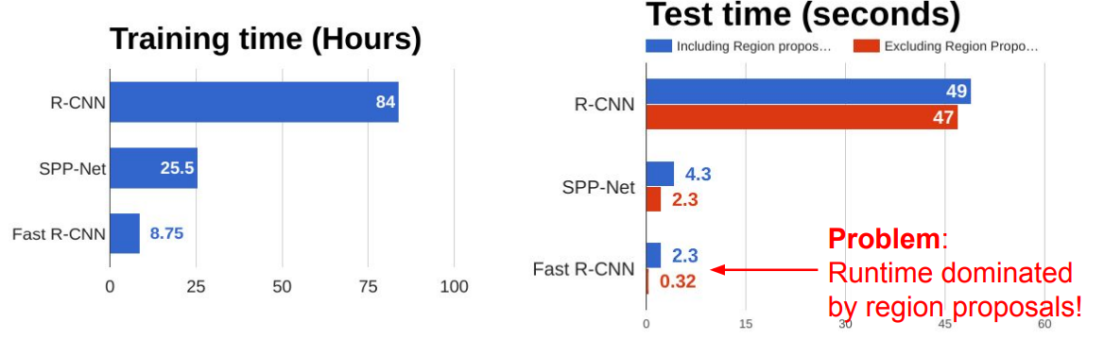
Faster RCNN
Faster R-CNN: Towards Real-Time Object Detection with Region Proposal Networks, Shaoqing Ren 2015, NIPS.

Slide 67
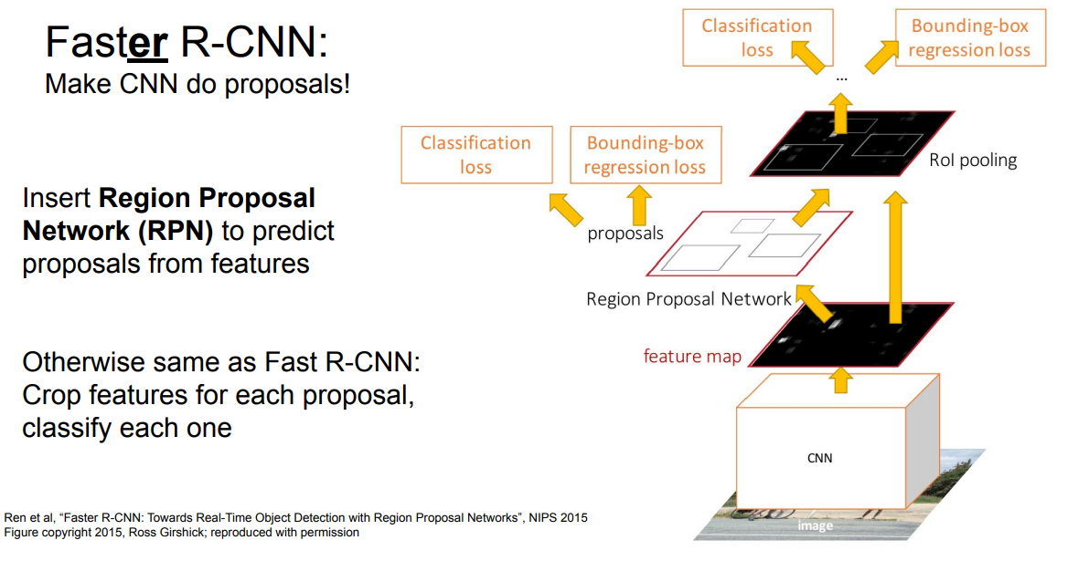

Slide 68
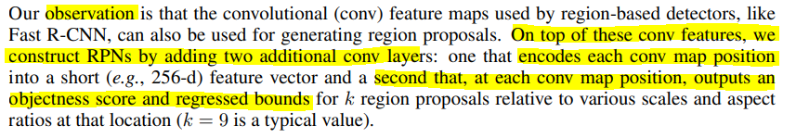

Slide 69
A Region Proposal Network (RPN) takes an image (of any size) as input and outputs a set of rectangular object proposals, each with an objectness score.
A fully convolutional layer.
Objectness: measure membership to a class Vs background.

Slide 70
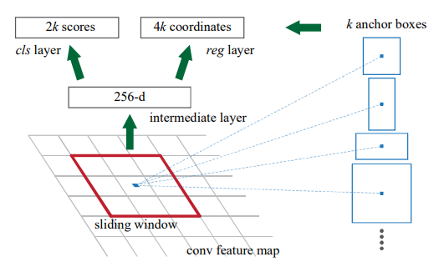
Important note: We do not have a separate Region Proposal network in FasterRCNN.
The FPN network is an add-on to the convNet (This is where we leverage pre-computed features).
Convs at the anchor boxes have already been computed by the backbone.

Slide 71
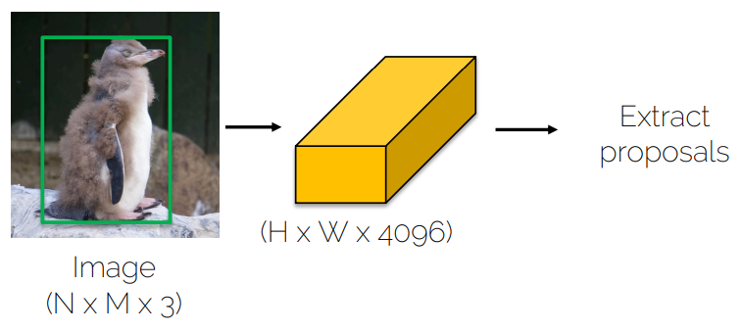
The question is now: How to extract proposals from the feature map?
Previousely (in RCCN, FastRCNN and SPP), we extracted proposals from the image directly.

Slide 72
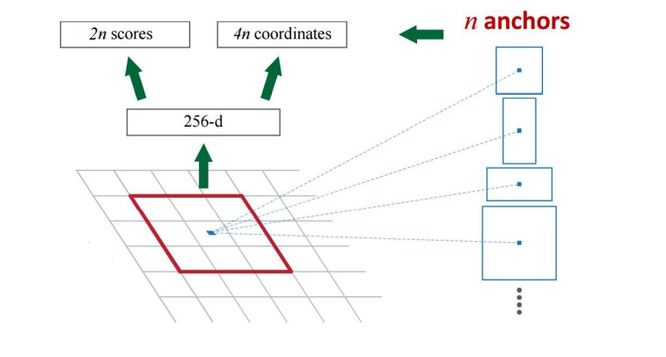
At each location of the HxWx4096 feature map, we fix a set of anchors of different sizes and aspect ratios (hopefully, one of them would contain an object).
We map the 9 anchors into a 256 vectors connected to a fully connected layer giving a score and a set of coordinates per anchor.

Slide 73

Summary: For each location in the feature map HxW, we extract a descriptor of size 256.

Slide 74

1x1 convolutions are used to transform the 256 feature map to a (2n + 4n) output.

Slide 75

So this is our RPN (a lot of shared computation + a little bit extra computations …)

Slide 76


How to train the RPN
P* indicates how much an anchor overlaps with the ground truth.
We choose randomly 256 anchors for each image. Loss function:
Loss of class: binary cross entropy
Regression loss is computed only for anchors where objects are detected

Slide 77

https://github.com/rbgirshick/py-faster-rcnn/blob/master/lib/rpn/generate_anchors.py
Jointly train with 4 losses:
1. RPN classify object / not object
2. RPN regress box coordinates
3. Final classification score (object classes)
4. Final box coordinates

Slide 78


Slide 79


Slide 80

FasterRCNN is 10x faster than FastRCNN

Slide 81


Slide 82


Slide 83

Source: https://arxiv.org/pdf/1611.10012.pdf Paper: Speed/accuracy trade-offs for modern convolutional object detectors, Huang et al.

Slide 84
Pytorch modules needed
DataSets:
https://pytorch.org/vision/stable/datasets.html
DataLoaders:
https://pytorch.org/docs/stable/data.html#torch.utils.data.DataLoader
Model (list des models screenshot)
https://pytorch.org/vision/0.8/models.html
Criterion (Aurelie)
Train / Eval

